Slide 1

Analyzing Factors Affecting Earbud Prices on Flipkart
TEAM:-
RAHUL MANDHABALA
VENKATARAO TELASANI
YOGI MALLIKARJUNA
MENTOR:
PUJALA BHANUPRAKASH

Slide 2

Exploratory Data Analysis
Problem Statement:
Analyzing Factors Affecting Earbud Prices on Flipkart
Objective:
To analyze how various features influence the selling price of earbuds on Flipkart and provide insights for both consumers and businesses.
Target Variable:
Selling Price
Independent Variables:
Product_Name
BrandBattery_Life_in_HRS
Drivers
Microphone_ENC
Additional_Features
Discount%
Selling_PriceRating

Slide 3
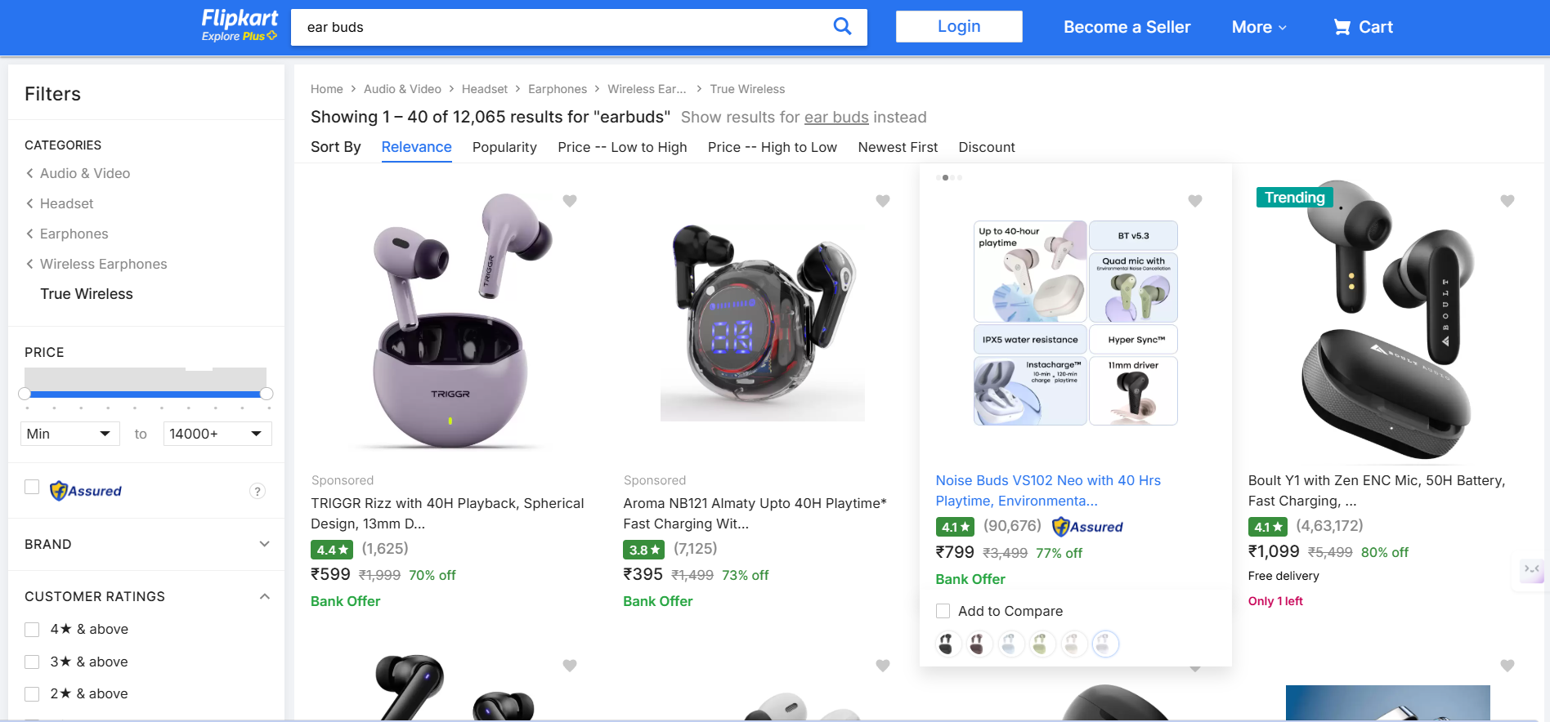
Web Scraping
Website:
https://www.flipkart.com/search?q=tws&otracker=search&otracker1=search&marketplace=FLIPKART&as-show=on&as=off&page
Web Scraping Tools:
Requests
BeautifulSoup

Slide 4
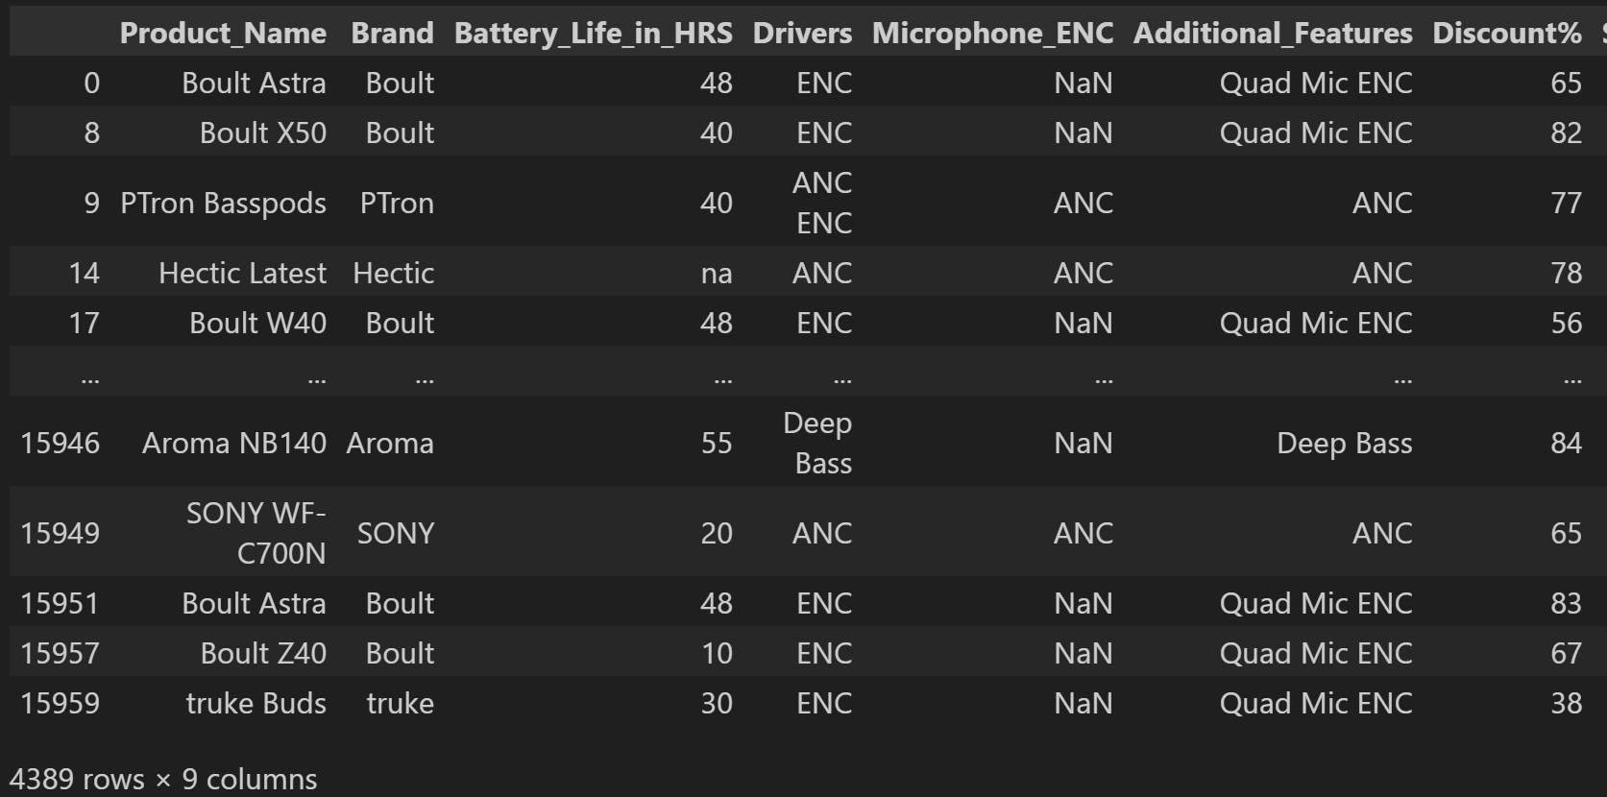
EDA
Data Cleaning:
Extracting Samples and features from raw data
Creating Data Frame
Analysing data types of features
Before cleaning:-

Slide 5
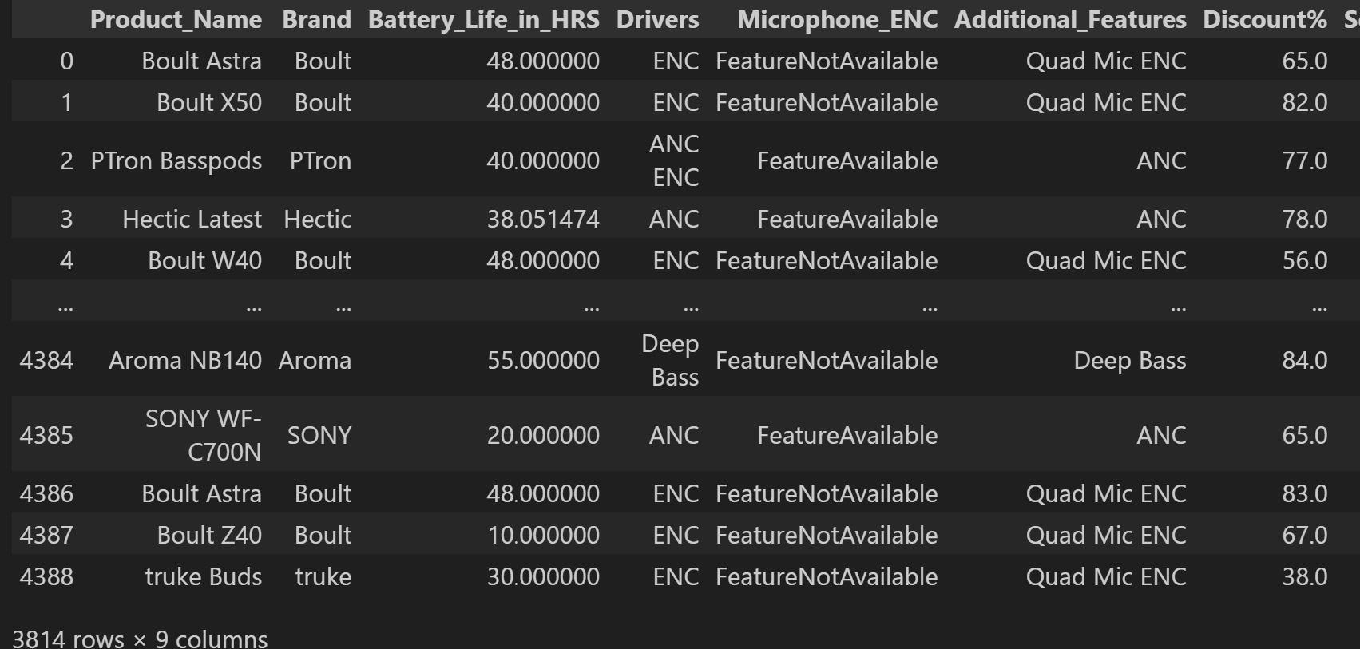
EDA
Data Cleaning:
Remove null values
Remove duplicates
Modifying datatypes
After cleaning:-

Slide 6
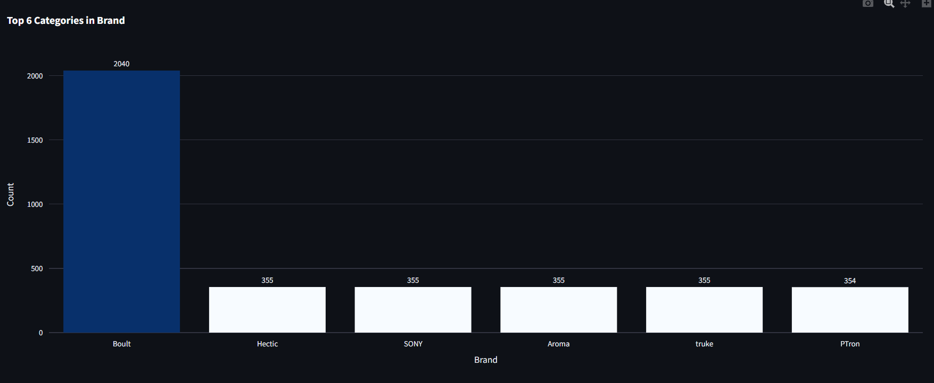
Data Visualization
Univariate Analysis:-
Insights:
Brand Dominance:
Boult has the highest count of products (2040), significantly ahead of other brands.
This indicates Boult's strong market presence and higher availability on Flipkart.

Slide 7
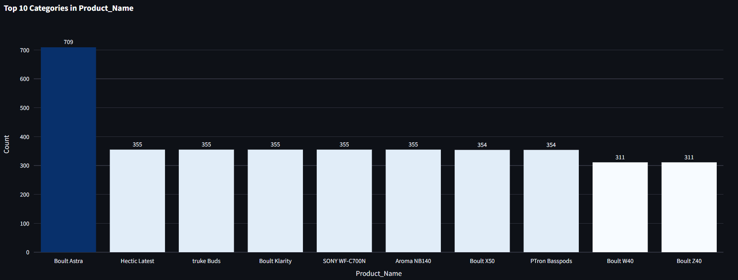
Data Visualization
Possible Actions:
For Boult: Capitalize on its market leadership by continuing aggressive marketing
For Other Brands: Differentiate by offering unique features, competitive pricing
For Consumers: Boult for alternatives with similar sales volumes and potential value-for-money options.

Slide 8
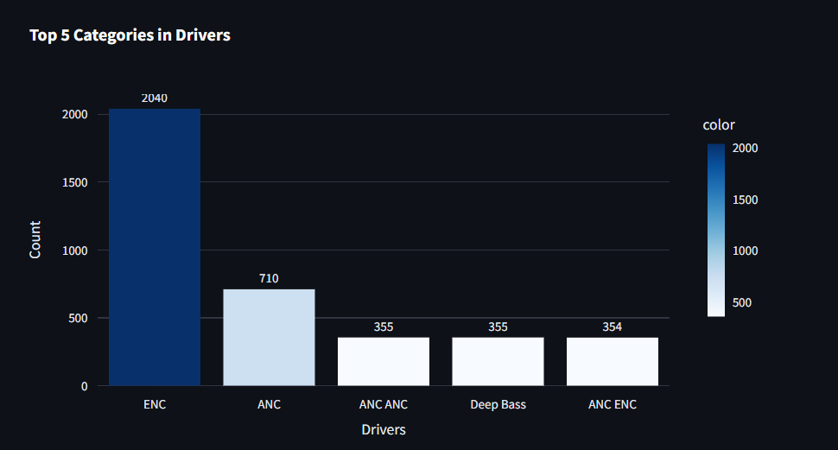
Data Visualization
ENC:
Environmental Noise Cancellation (ENC)
ANC:
Active Noise Cancellation (ANC)
Insight: ENC is widely adopted across different price segments, while ANC remains a premium feature

Slide 9
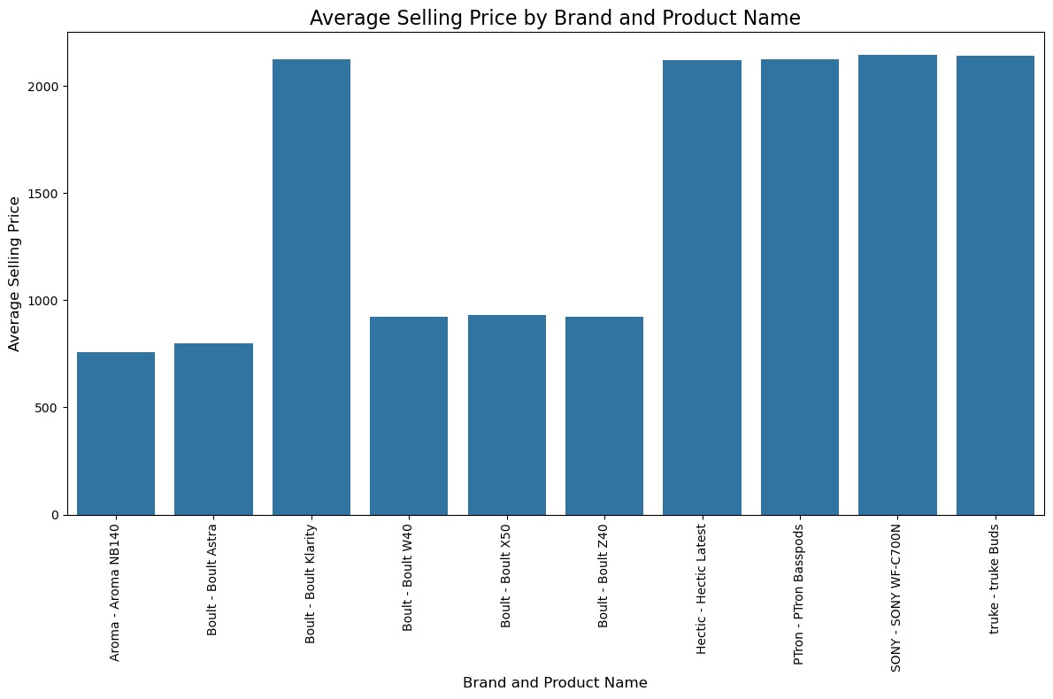
Data Visualization
Bivariate Analysis:-
Insight:
High-end brands like Sony, PTron, and Hectic have the highest average selling prices (~2000 INR), while budget-friendly brands like Aroma and Boult offer models in the range of 700–900 INR, with Boult showing significant price variations across its models.

Slide 10
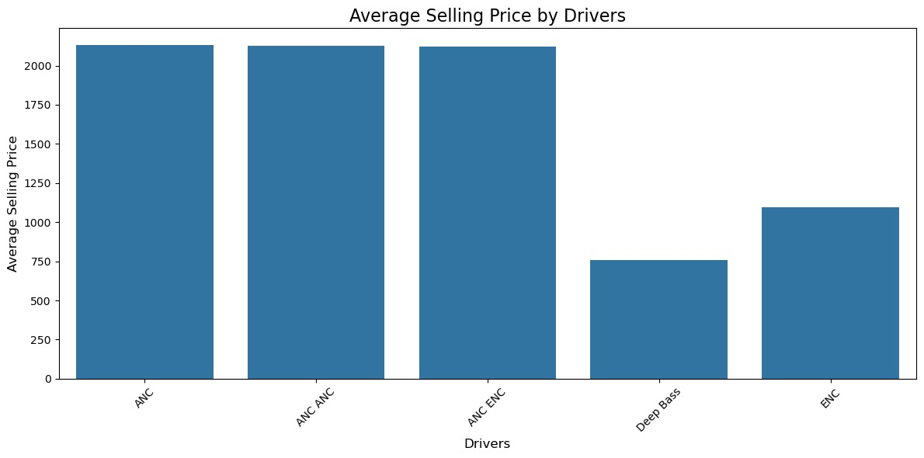
Data Visualization
Insight:
Earbuds with ANC (Active Noise Cancellation) and ENC (Environmental Noise Cancellation) tend to have significantly higher selling prices, while those with Deep Bass and only ENC are priced lower. This indicates that noise cancellation technology is a key factor driving up prices in the market.

Slide 11
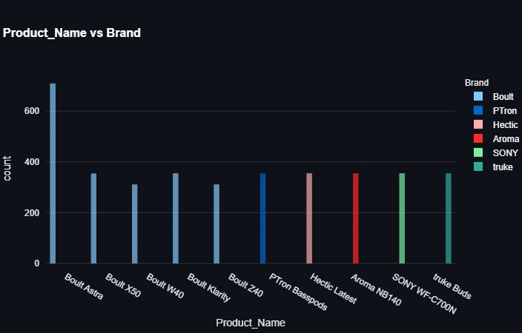
Data Visualization
Brand | Product Name | Count
Boult | Boult Astra | 680
Boult | Boult X50 | 350
Boult | Boult W40 | 330
Boult | Boult Kairity | 320
Boult | Boult Z40 | 310
PTron | Ptron Bass pods | 340
Hectic | Hectic Latest | 330
Aroma | Aroma NB140 | 330
SONY | SONY WF_C700N | 340
truke | Truke Buds | 340
Insight:
Boult has the highest product count, making it the most dominant brand in the dataset, while other brands have fewer products listed.

Slide 12
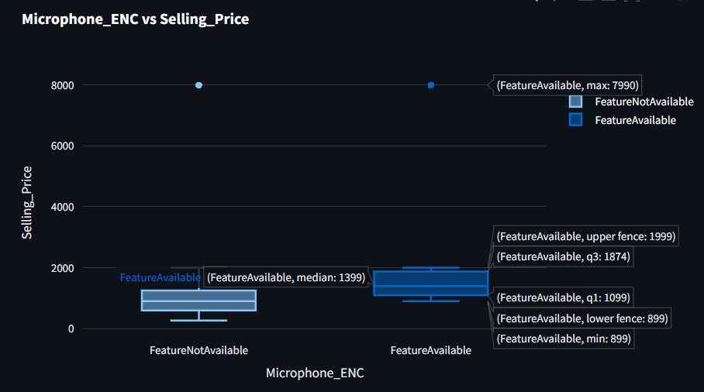
Data Visualization
Insight:
ENC increases the average selling price of earbuds.
High-end ENC models contribute to significant outliers in price distribution.

Slide 13
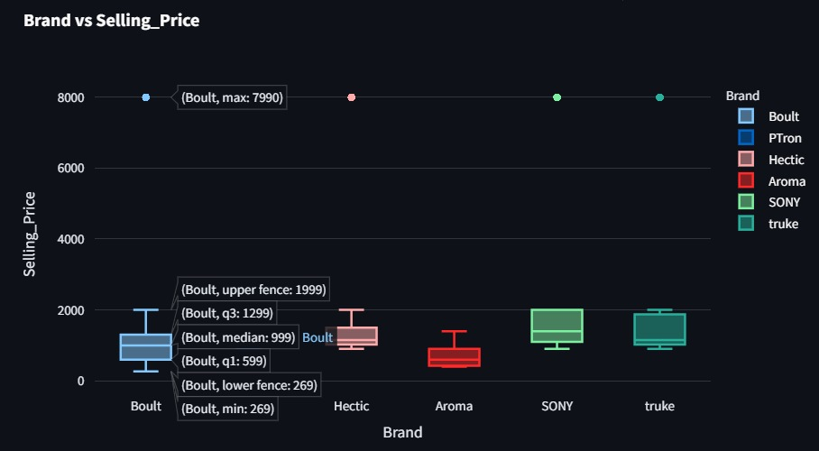
Data Visualization
Insight:
The box plot shows that Boult has the widest price range, with a few outliers reaching up to ₹7990, while most other brands have lower median prices and a narrower price distribution.

Slide 14
1. Features like Noise Cancellation, Brand, and Connectivity have the highest impact on price. 2. Customer Ratings moderately affect pricing. 3. Wireless earbuds generally cost more than wired ones. Business Implications: Sellers should highlight premium features to justify higher pricing.
Conclusion
Future Scope :
Expanding dataset across multiple e-commerce platforms.
Building a price prediction model using Machine Learning.
Developing a real-time dashboard for dynamic price tracking.

Slide 15
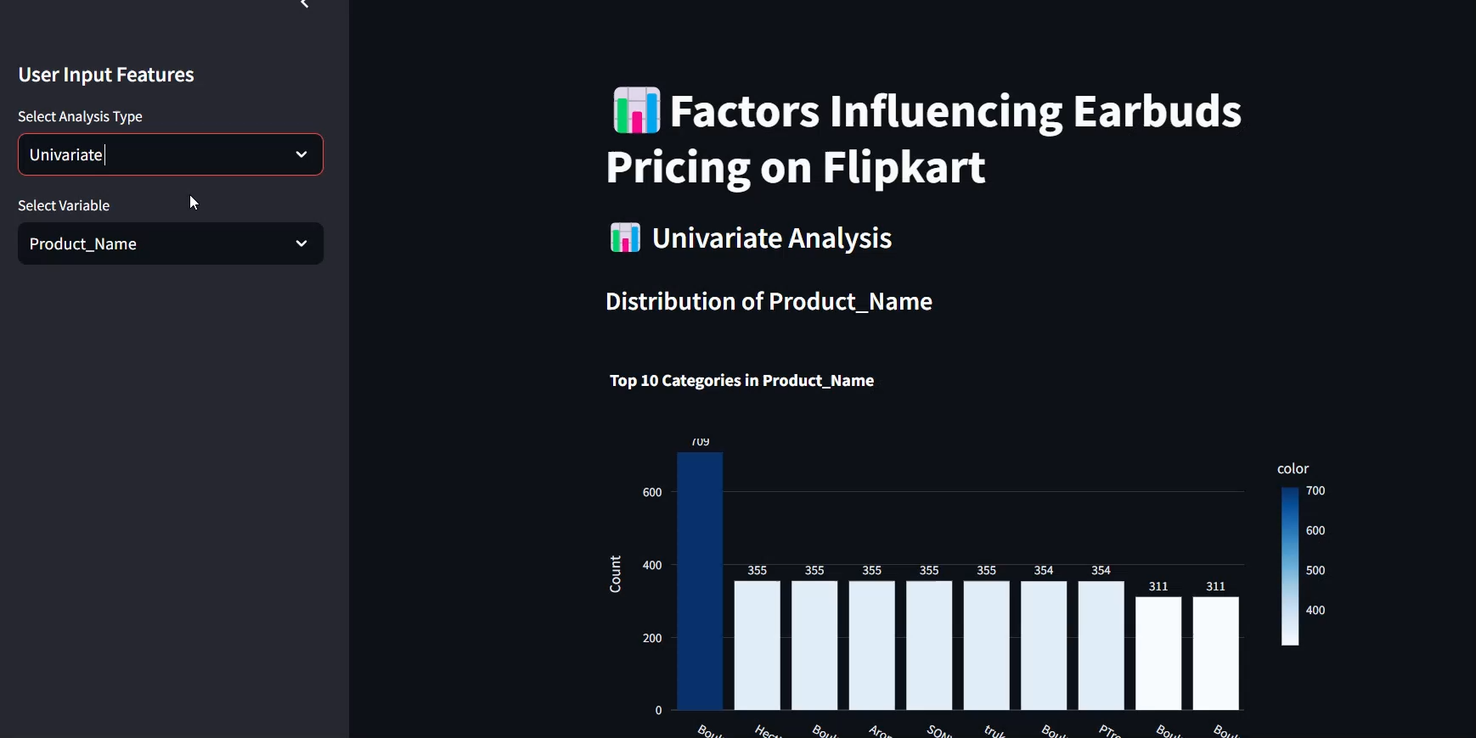
Demo Video

Slide 16


Slide 17

THANK YOU

